Slide 1


Non-additive measures for quantum probability?
Gabriele Carcassi and Christine Aidala
University of Michigan

Slide 2


Goal of the overall project
Identify a handful of physical starting points from which the basic laws can be rigorously derived
Reverse Physics
Physics
Smallest set of assumptions required to rederive the theory
Physical theory
Physical result/ effect/prediction
https://assumptionsofphysics.org
Reverse physics: Start from the equations and identify principles and assumptions
Physical mathematics: Start from scratch and rederive all mathematical structures from physical requirements
Physics
Physical requirements
Semantics
Physical mathematics

Slide 3
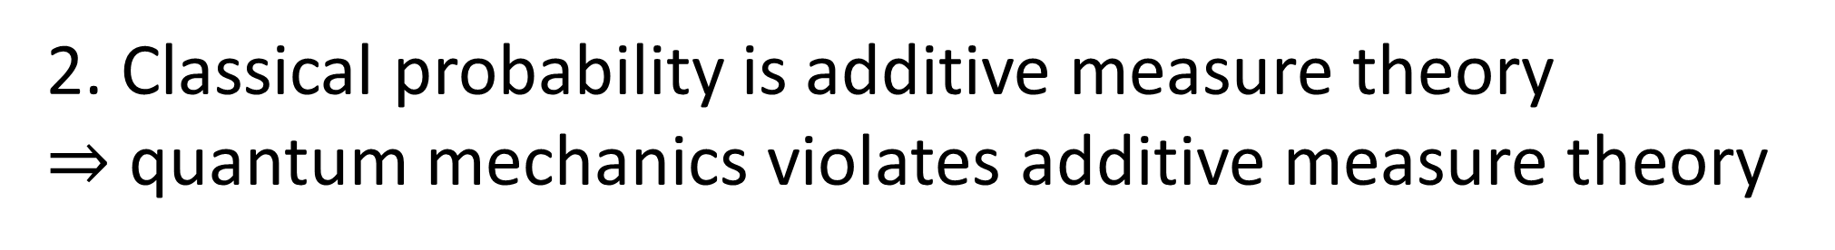
1. Quantum mechanics violates classical probability
2. Classical probability is additive measure theory $⇒$ quantum mechanics violates additive measure theory
3. Can we use non-additive measure theory for a physically meaningful generalization?
4. What tools would (or would not) work?

Slide 4
Classical probability and quantum mechanics

Slide 5
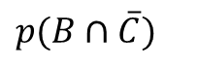
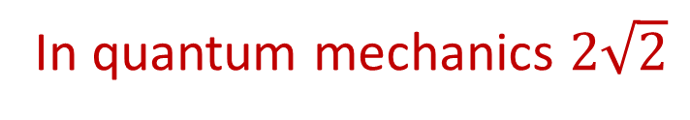
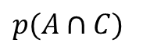
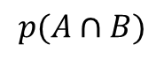
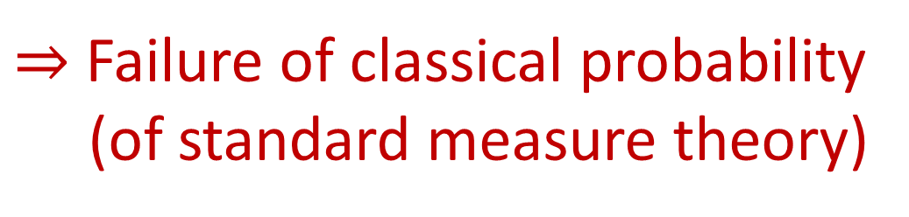

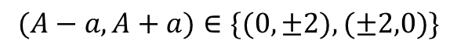

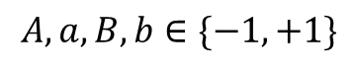
A (spin is up)
B (spin is right)
$$p(A∩B)$$
$$p(A∩C)$$
$$p(B∩\overline{C})$$
$$≤$$
$$+$$
Bell type inequality
C (spin is up-right)
Violated by quantum mechanics
CHSH inequality
$$A,a,B,b∈\{−1,+1\}$$
$$(A−a,A+a)∈\{(0,±2),(±2,0)\}$$
$$\left|\left\langle AB\right\rangle −\left\langle Ab\right\rangle −\left\langle aB\right\rangle −\left\langle ab\right\rangle \right|≤2$$
In quantum mechanics $2\sqrt{2}$
$⇒$ Failure of classical probability
(of standard measure theory)

Slide 6
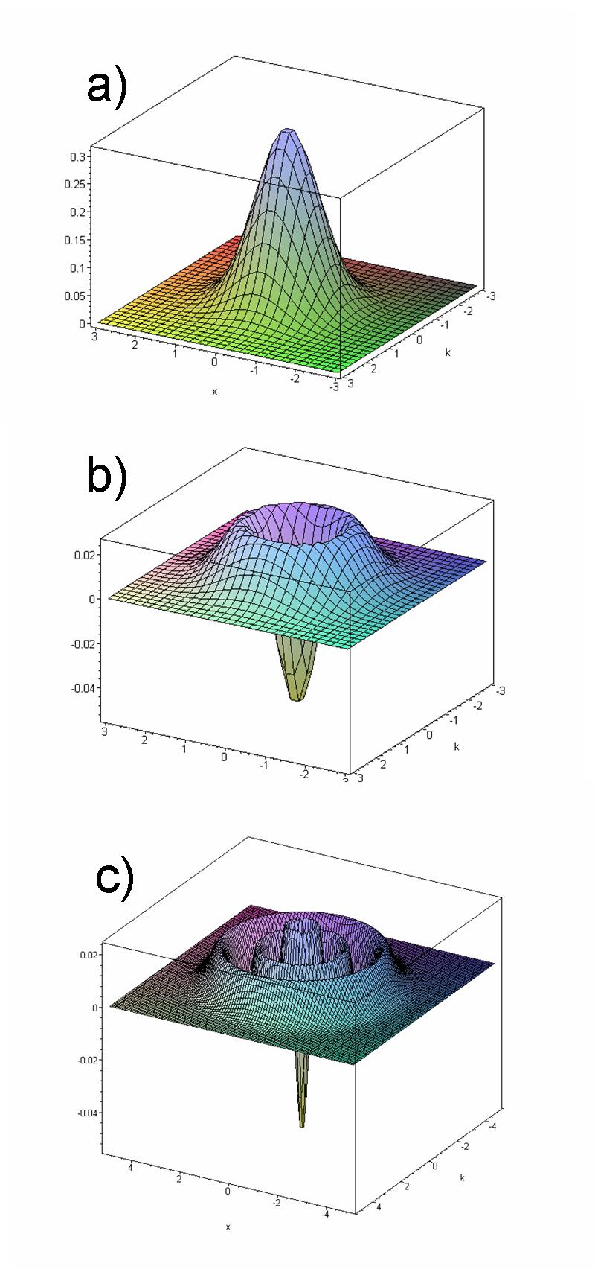
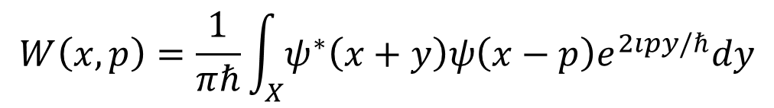
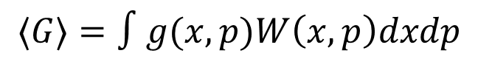
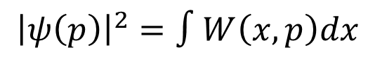
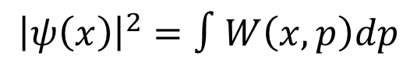
Quasi-probability distribution
Wigner function for first two solutions of the harmonic oscillator
Sample space is not the state space
Wigner function
$$W\left(x,p\right)=\frac{1}{πℏ}\int_{X}{ψ^{∗}\left(x+y\right)ψ\left(x−p\right)e^{2ıpy/ℏ}dy}$$
Can be negative: no clear meaning
Recovers marginal distributions
$${\left|ψ\left(x\right)\right|}^{2}=∫W\left(x,p\right)dp$$
$${\left|ψ\left(p\right)\right|}^{2}=∫W\left(x,p\right)dx$$
$$⟨G⟩=∫g(x,p)W\left(x,p\right)dxdp$$
Acts as a probability density to recover probabilities and expectation values
Additive under statistical mixing
Density first (not measure first)
Not clear what densities are allowed or not

Slide 7
Can we find a generalization of probability theory that works in the same way in both classical and quantum mechanics?
Sample space is the respective state space
Probability defined as a set function on the sample space
Expectations recovered as integral of some function of the sample space
…
What set function for probability?
What integral for expectation?
What derivative for probability density?

Slide 8
Ensemble spaces and mixing probability

Slide 9
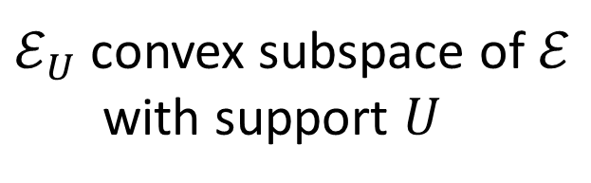
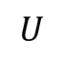
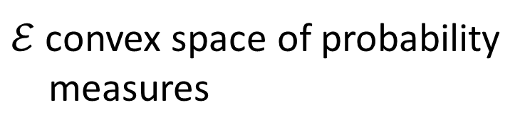
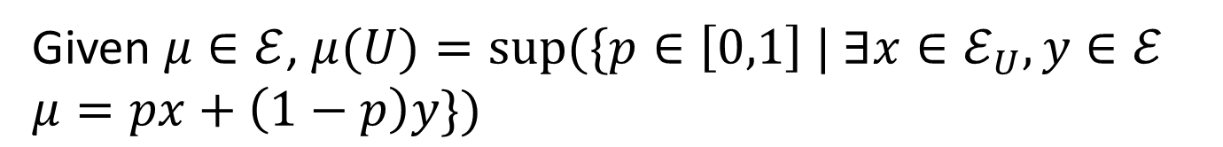
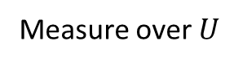
Probability as biggest coefficient when mixing measures
Measure over whole space
$$U$$
$ℰ$ convex space of probability measures
$$p\left(A\right)=p\left(A|U\right)p\left(U\right)+p\left(A|U^{C}\right)p\left(U^{C}\right)$$
Measure over $U$
$ℰ_{U}$ convex subspace of $ℰ$ with support $U$
Coefficient of convex combination
Given $μ∈ℰ$, $μ(U)=sup(\{p∈\left[0,1\right] | ∃x∈ℰ_{U},y∈ℰ$ $μ=px+\left(1−p\right)y\})$
This we can generalize to quantum mechanics (to any convex set)

Slide 10
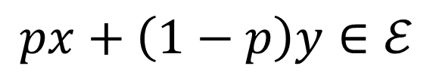
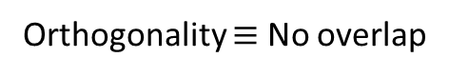
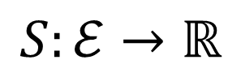
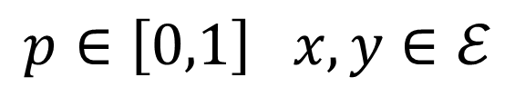
General structure for space of ensembles
Convex structure
$$px+\left(1−p\right)y∈ℰ$$
$$p∈\left[0,1\right] x,y∈ℰ$$
Concave entropy
$$S:ℰ→ℝ$$
Increase of entropy due to mixing is bound
$$0≤S\left(px+\left(1−p\right)y\right)−\left(pS\left(x\right)+\left(1−p\right)S\left(y\right)\right)≤I\left(p,1−p\right)$$
Semi-metric
No increase
Max increase = Shannon entropy
Equality
Orthogonality $≡$ No overlap

Slide 11
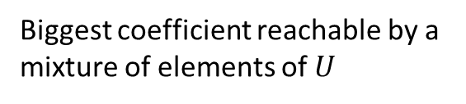
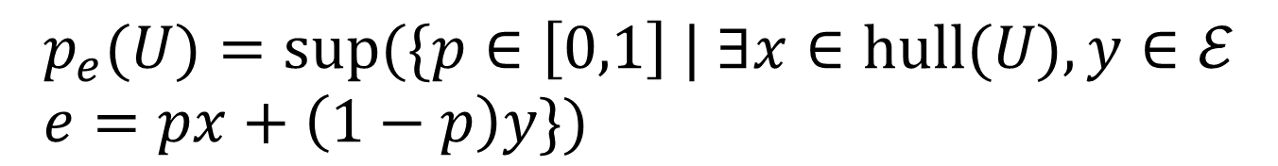
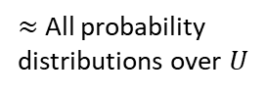
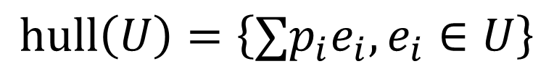
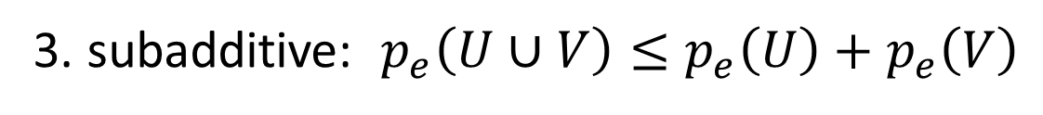
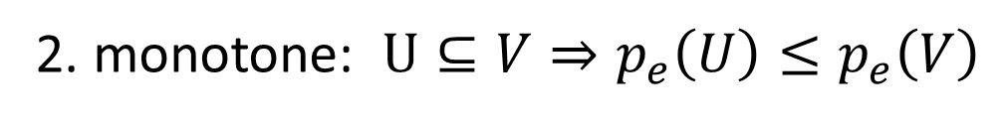
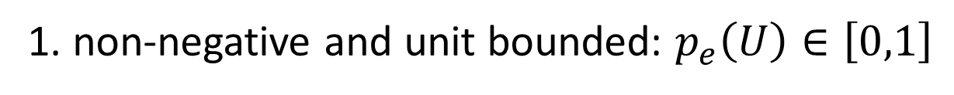
Mixing probability
All convex combinations
Hull
$$hull\left(U\right)=\left\{∑p_{i}e_{i}, e_{i}∈U\right\}$$
$≈$ All probability distributions over $U$
Probability
$$p_{e}(U)=sup(\{p∈\left[0,1\right] | ∃x∈hull(U),y∈ℰ \\ e=px+\left(1−p\right)y\})$$
Set function
Biggest coefficient reachable by a mixture of elements of $U$
1. non-negative and unit bounded: $p_{e}\left(U\right)∈\left[0,1\right]$
2. monotone: $U⊆V⇒p_{e}\left(U\right)≤p_{e}\left(V\right)$
3. subadditive: $p_{e}\left(U∪V\right)≤p_{e}\left(U\right)+p_{e}\left(V\right)$
Additive on subspaces that can be orthogonally decomposed

Slide 12
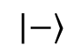
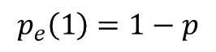
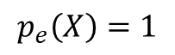
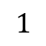
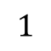
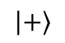
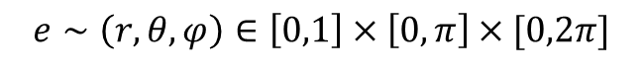
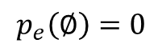
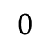
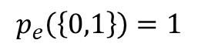
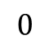
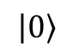
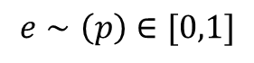
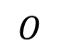
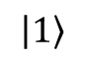
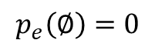
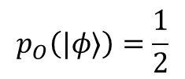
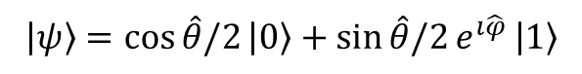
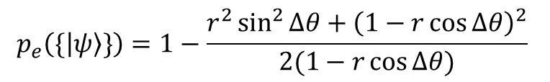
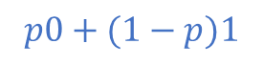
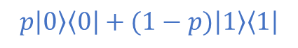


Two-state system (bit and qubit)
pure states
$$1$$
pure states (superpositions)
mixtures
Quantum
Classical
$$\left|ψ\right\rangle =\cos{\hat{θ}/2}\left|0\right\rangle +\sin{\hat{θ}/2}e^{ı\hat{φ} }\left|1\right\rangle$$
$$p0+(1−p)1$$
$$\left|1\right\rangle$$
Bloch ball
Complex projective Hilbert space
2D simplex
$$\left|−\right\rangle$$
$$O$$
$$\left|+\right\rangle$$
$$e∼\left(p\right)∈[0,1]$$
$$0$$
$$p_{e}\left(∅\right)=0$$
$$p_{e}\left(\left\{0,1\right\}\right)=1$$
$$e∼\left(r,θ,φ\right)∈\left[0,1\right]×\left[0,π\right]×[0,2π]$$
$$\left|0\right\rangle$$
mixtures
$$p_{e}\left(0\right)=p$$
$$p_{e}\left(1\right)=1−p$$
$$p\left|0\right\rangle \left\langle 0\right|+(1−p)\left|1\right\rangle \left\langle 1\right|$$
$$p_{e}\left(∅\right)=0$$
$$p_{e}\left(X\right)=1$$
$$p_{e}\left(\{\left|ψ\right\rangle \}\right)=1−\frac{r^{2}\sin^{2}{Δθ}+{\left(1−r\cos{Δθ}\right)}^{2}}{2(1−r\cos{Δθ})}$$
$$p_{\left|ψ\right\rangle }\left(|φ⟩\right)=\left\{\begin{aligned}1 ψ=φ \\ 0 ψ≠φ\end{aligned}\right.$$
$$p_{O}\left(|φ⟩\right)=\frac{1}{2}$$
$$0$$
$$1$$
lowest entropy
highest entropy

Slide 13













$$a$$
$$r\sin{Δθ}$$
$$1−r\cos{Δθ}$$
$$p=1−\frac{\overline{ae}}{\overline{ab}}=1−\frac{\overline{ae}}{2\sin{\frac{α}{2}}}=1−\frac{\overline{ae}}{2\frac{\overline{ac}}{\overline{ae}}}=1−\frac{{\overline{ae}}^{2}}{2\overline{ac}}$$
$$c$$
$$\frac{α}{2}$$
$$e$$
$$r\cos{Δθ}$$
$$Δθ$$
$$=1−\frac{{\left(r\sin{Δθ}\right)}^{2}+{\left(1−r\cos{Δθ}\right)}^{2}}{2(1−r\cos{Δθ})}$$
$$α$$
$$b$$
$$r$$
$$Δθ$$

Slide 14

The non-additivity is caused by the possible multiple decompositions
$$\left|1\right\rangle$$
Classical probability: single decomposition in pure states
Quantum probability: multiple decompositions in pure states
$$\left|−\right\rangle$$
$$\left|+\right\rangle$$
$$\left|0\right\rangle$$
Finite probability on each point of a continuum
High degree of non-additivity
$$p_{O}\left(X\right)=1≤\sum_{X}{p_{O}\left(\left\{x\right\}\right)}=\frac{1}{2}\left|ℝ\right|$$
Uncountably many possible decompositions
E.g. for maximally mixed state

Slide 15













$$F\left(px+\left(1−p\right)y\right) \\ =pF\left(x\right)+\left(1−p\right)F(y)$$
Random variables
$$F:ℰ→ℝ$$
$$F_{1}$$
Classical
$$pF_{0}+\left(1−p\right)F_{1}$$
Quantum
Max and min ($F_{a}$ and $F_{b}$) must be on opposite points
$$\left|1\right\rangle$$
$$F_{b}$$
Bloch ball
Complex projective Hilbert space
2D simplex
$$\left|−\right\rangle$$
$$\left|+\right\rangle$$
$$F_{0}$$
$$F_{a}$$
$$\left|0\right\rangle$$
$$pF_{a}+\left(1−p\right)F_{b}$$
$$f\left(x\right)=F\left(\left\{x\right\}\right)$$
$$f\left(x\right)=F\left(\left\{x\right\}\right)$$
$$E\left[F\right]=∑f\left(x\right)p\left(x\right)=F\left(e\right)$$
$$E\left[F\right]=\hat{∑}f\left(x\right)p\left(x\right)=F\left(e\right)$$
???
This is what needs to be generalized to a continuum for integral/derivative

Slide 16
Entropy and count of states

Slide 17



Classical statistical mechanics links count of states and entropy
$$S\left(ρ_{U}\right)=\log{μ\left(U\right)}$$
Count of states
Shannon/Gibbs entropy
Uniform distribution over $U$
Fundamental postulate of statistical mechanics
Quantum statistical mechanics has a somewhat related expression
$$S\left(ρ_{U}\right)≤\log\left(\dim_{ℂ}{(\operatorname{span}\left(U\right)}\right)$$
Equal for a uniform distribution over $\operatorname{span}\left(U\right)$
Von Neumann entropy
Uniform distribution over $U$
Dimensionality of subspace
Generalized expression?

Slide 18




Exponential of the entropy has key property
Proof is mere calculation

Slide 19


Exponential of the highest entropy reachable through convex combinations
Define
$stateCount (U)=sup\left(2^{S\left(hull\left(U\right)\right) }\right)$
Set function
1. non-negative: $stateCount\left(U\right)∈\left[0,+∞\right]$
2. monotone: $U⊆V⇒stateCount\left(U\right)≤stateCount\left(V\right)$
3. subadditive: $stateCount\left(U∪V\right)≤stateCount\left(U\right)+stateCount\left(V\right)$
Additive on subspaces that can be orthogonally decomposed
Recovers number of states for discrete classical spaces, Liouville measure for continuous classical spaces, dimension of the subspaces in quantum mechanics

Slide 20




























Need for non-additive measure
Single point
Finite continuous range
$$A$$
$$μ(U)$$
$$\log{μ(U)}$$
$$μ(U)$$
$$\log{μ(U)}$$
$$C$$
Counting measure
$$μ\left(U\right)=\#U$$
$1$
$0$
$+∞$
$+∞$
$$B$$
Number of points
$$μ\left(\left\{A\right\}\right)=2^{0}=1$$
Lebesgue measure
$$μ\left(\left\{A,B\right\}\right)=2^{1}=2$$
not additive
$$μ\left(\left[a,b\right]\right)=b−a$$
$0$
$−∞$
$<∞$
$<∞$
$$μ\left(\left\{A,C\right\}\right)<2=μ\left(\left\{A\right\}\right)+μ\left(\left\{C\right\}\right)$$
Interval size
“Quantized” measure
In quantum mechanics, literally $1+1≤2$
$$μ\left(U\right)=sup(2^{S(hull(U))})$$
$1$
$0$
$<∞$
$<∞$
Entropy over uniform distribution
Pick two!
Single point is a single case (i.e. $μ\left(\left\{ψ\right\}\right)=1$)
Finite range carries finite information (i.e. $μ\left(U\right)<∞$)
Measure is additive for disjoint sets (i.e. $μ\left(∪U_{i}\right)=∑μ\left(U_{i}\right)$)
Physically, we count states all else equal
Contextuality $⟺$ non-additive measure

Slide 21
Summary
In Assumptions of Physics (https://assumptionsofphysics.org) we are looking for a generalized setting for both classical and quantum probability
The setting is the convex space of ensembles at equilibrium (i.e. statistical distributions): can be mixed and have an entropy defined
This generalization requires non-additive measures to deal with multiple decompositions (i.e. quantum contextuality)
Non-additive measures are not typically used in quantum foundations
Looking for discussion/advice/collaboration/…
Same generalization connects other areas of math and physics
Information theory and information geometry
Functional analysis and spectral theory
Order theory and quantum logic

Slide 22

For more information
Gabriele Carcassi
Instructive videos for undergrads and above
https://www.youtube.com/@gcarcassi
https://www.youtube.com/@AssumptionsofPhysicsResearch
Videos about active research
carcassi@umich.edu
https://assumptionsofphysics.org
Thanks to all participants that have shared insights and ideas
Special thanks to Vicenç Torra and Zuzana Ontkovičová

